Slide 1

Car Rental System
Presented By: Yash, Yarima, Farhana

Slide 2
Project Background
In recent years, the transportation industry has seen a significant shift towards shared mobility services, with car rental businesses playing a vital role in offering flexible and cost-effective transportation options. Traditionally, car rental operations have relied on manual systems for managing vehicles, customer records, rentals, and maintenance schedules. These outdated methods are often error-prone, time-consuming, and lack real-time insights into vehicle availability and customer transactions.
As the demand for rental services grows, especially in urban and tourist areas, there is an increasing need for a robust and efficient digital platform to streamline rental operations. This system should ensure data integrity, maintain service records, and provide a smooth rental experience for both the customers and the staff. The solution should also be scalable, secure, and capable of handling complex relationships between different entities such as cars, customers, rentals, and maintenance.

Slide 3
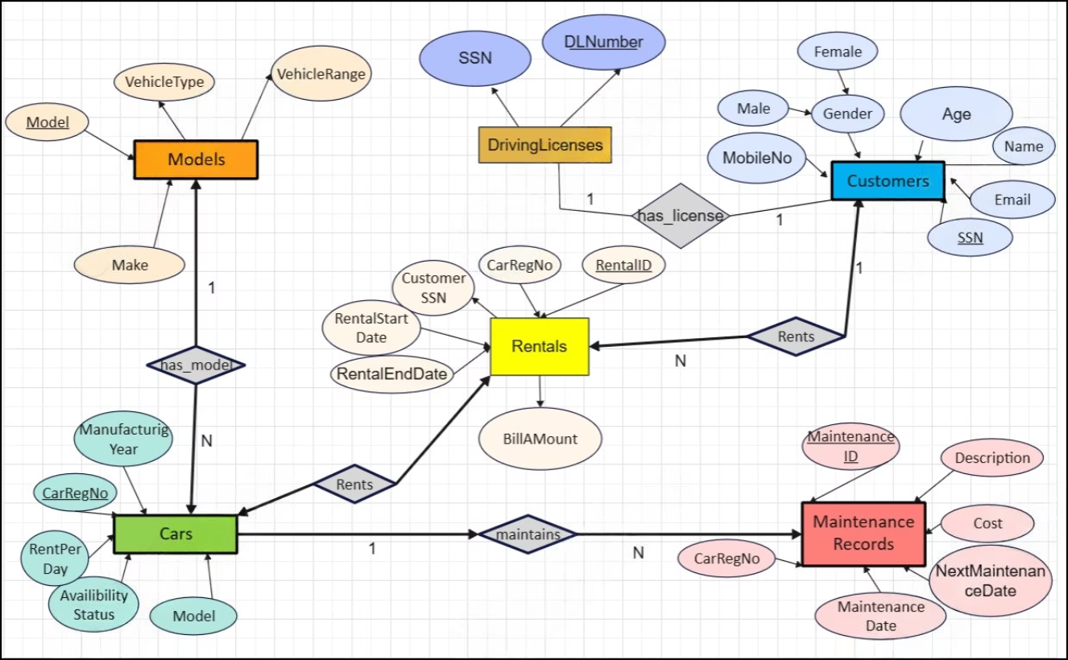
ER Diagram

Slide 4
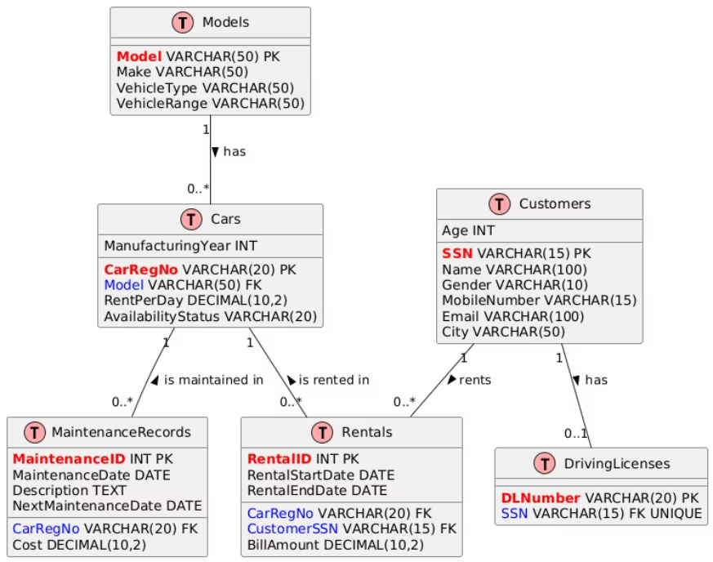
Conversion of ER diagram into Tables

Slide 5






Description of Tables
Models
Stores general information about car models, including Make, VehicleType, and VehicleRange.
Cars
Contains individual car details available for rent, such as CarRegNo, Model, ManufacturingYear, and RentPerDay.
Customers
Stores customer personal information, including SSN, Name, Gender, Age, MobileNumber, and Email.
DrivingLicenses
Stores driving license numbers linked to customers.
Rentals
Captures rental transaction data between cars and customers.
MaintenanceRecords
Tracks maintenance performed on each car.

Slide 6
Normalization to BCNF
1NF & 2NF
1
Remove attributes that depend on part of a composite key, but only single-attribute primary keys exist. Therefore, no changes required.
3NF
2
Break down dependencies that aren't directly related to the primary key.
BCNF
3
Every determinant is a candidate key.
Normalization of tables up to BCNF involves several steps to ensure data integrity and reduce redundancy. This includes removing partial dependencies, transitive dependencies, and ensuring that every determinant is a candidate key. The original tables are refined to achieve BCNF, resulting in a more efficient and reliable database structure.

Slide 7
Foreign Keys Used
Foreign Keys
References
Relationship
Cars.Model
Models.Model
One Model → Many Cars
Rentals.CustomerSSN
Customers.SSN
One Customer -> Many Rentals
Rentals.CarRegNo
Cars.CarRegNo
One Car → Many Rentals
MaintenanceRecords.CarRegNo
Cars.CarRegNo
One Car → Many Maintenance Records
DrivingLicenses.SSN
Customers.SSN
One Customer → One License
Foreign keys are used to establish relationships between tables, ensuring data integrity and relational queries. These keys link related data across tables, allowing for efficient data retrieval and management.

Slide 8
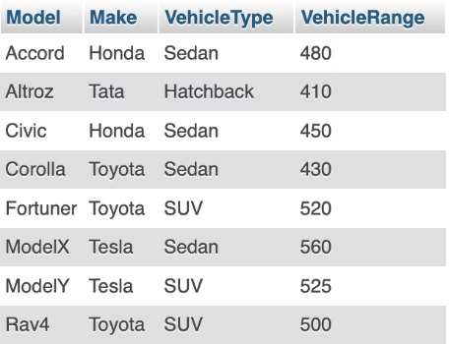
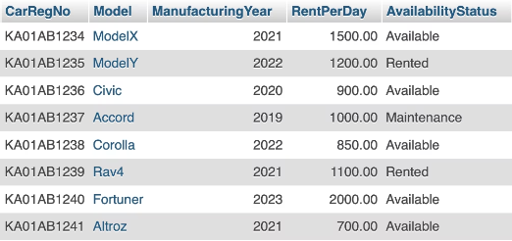
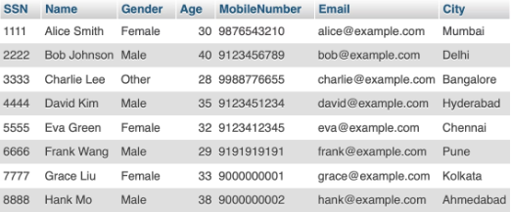
Creation of Data in the Tables
Customers
Cars
Models

Slide 9
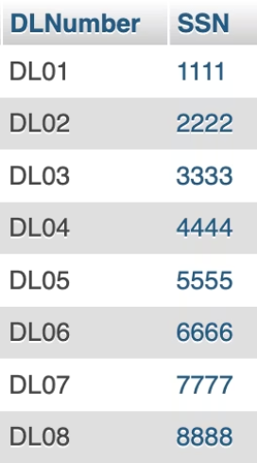
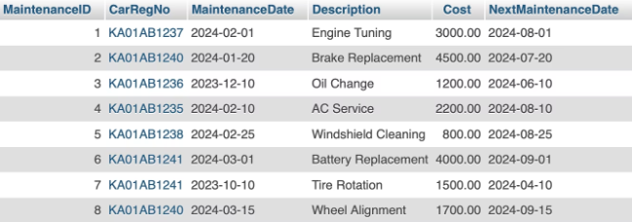
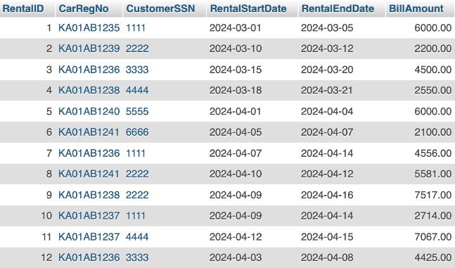
Creation of Data in the Tables
Maintenance Records
Car Rentals
Driving Licenses

Slide 10
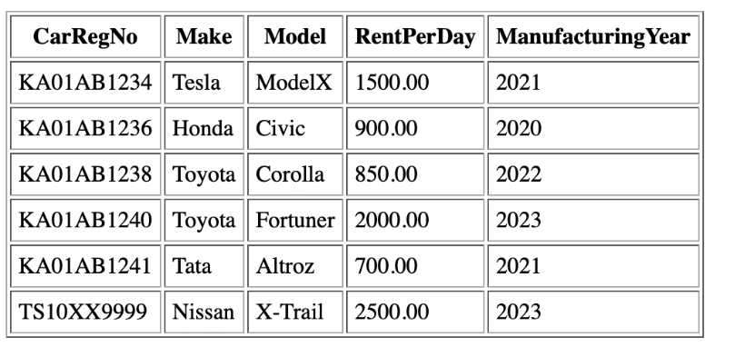
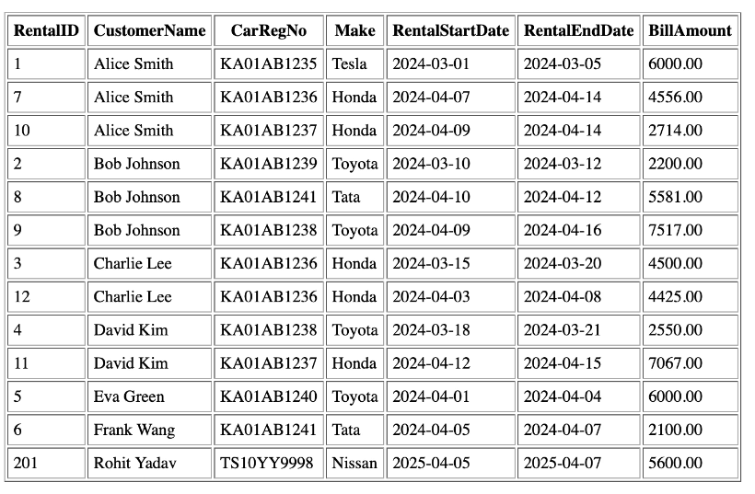
Views
Available Cars
Car Rentals

Slide 11
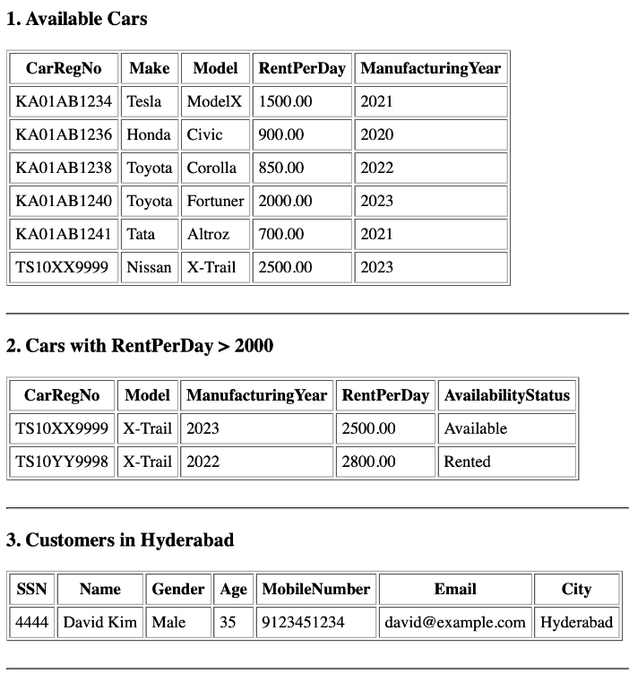
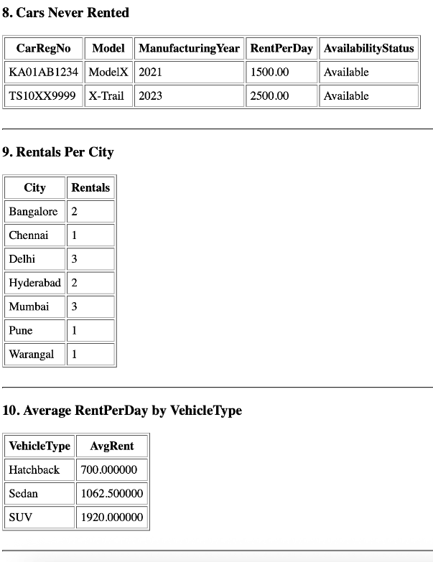
SQL Queries

Slide 12

Conclusion
In conclusion, this Car Rental Management System effectively demonstrates a robust and normalized relational database design that ensures data integrity and efficient management of various components including cars, models, customers, rentals, driving licenses, and maintenance records. Implemented using MySQL, the system supports a wide range of SQL operations including complex joins, nested queries, views, and aggregations—providing a solid backend foundation for analytical reporting and real-time data access. With a scalable structure and practical sample data, it showcases how database-driven applications can streamline operations and enhance decision-making in real-world rental businesses.

Slide 13
Thank You.

